Slide 1
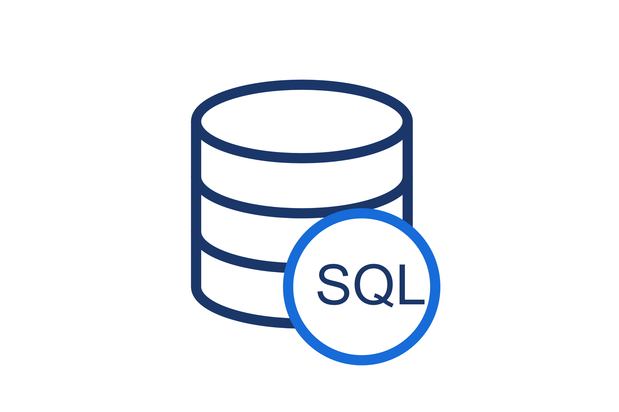
SQL Project
Topic :- Tour and Travel Management System.
- Abhishek More

Slide 2

Data
Data is collection of Raw Facts and figure.
Raw means that the facts are Unprocessed.

Slide 3

Information
Information is a Process form of Data.
Information Is always Meaningful.
Information is Dependent on data

Slide 4
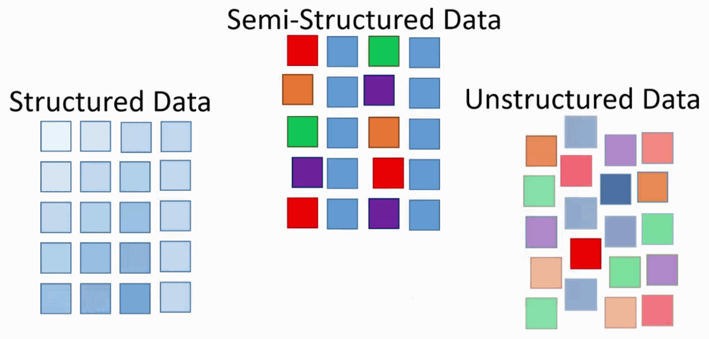
Data Types
Structured Data :- Oracle , MYSQL,MSSQL.
Semi-Structured Data :- CSV , MongoDB.
Unstructured Data :- PDFs, JPEGs, MP4.

Slide 5

Database
Database is a digital system for storing and organizing information so it can be easily accessed and managed.

Slide 6

DBMS ( Database Management Systems )
Database Management Systems (DBMS) are software systems used to store, retrieve, and run queries on data.

Slide 7
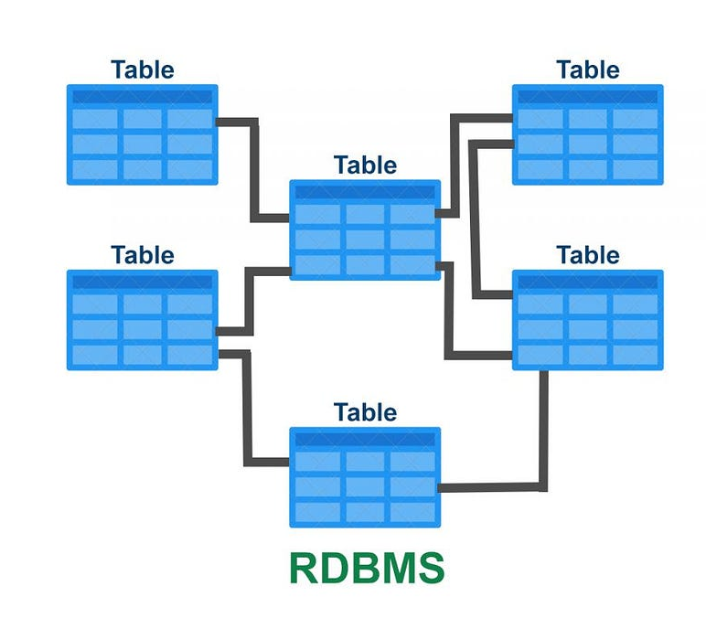
RDBMS (Relational Database Management System )
It's a type of database management system (DBMS) that stores data in a structured format, using rows and columns.
Relational refers to a method of organizing data into tables that are related to each other by common attributes.

Slide 8
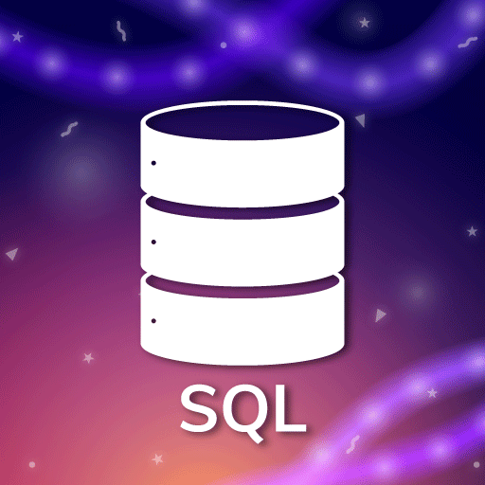
SQL (Structured Query Language)
SQL Introduced by IBM in 1979’s
It Used To Storing And Managing Data In Relational Database Management System.

Slide 9
SQL Commands
DDL
DML
DQL
Aggregate
Function
Filtering Data
Combining Data

Slide 10
DDL ( Data Definition Language )
Data Definition Language is used to define the structure of the Database.
DDL Commands :-
1) Create.
2) Alter.
3) Drop.
4) Truncate

Slide 11


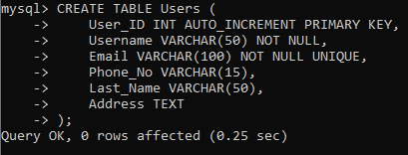
1) Create.
Create command in SQL that is used to make new tables, databases.
Create Database:-
Use Database :-
Create Tables :-

Slide 12

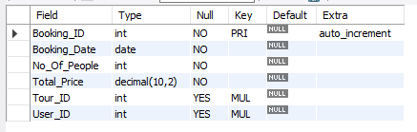
2) Alter
These command used to modify an existing database object, like a table or column.
ADD CONSTRAINT using alter commands:
Output :-

Slide 13

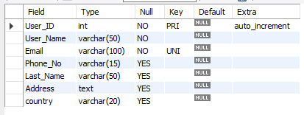
Rename column Name using alter commands:
Output:-

Slide 14
Add column Specific location using alter commands:
Output:-

Slide 15

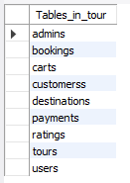
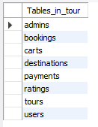
3) Drop Table :-
The DROP TABLE statement is used to drop an existing table in a database.
Output :-
Before :-
After :-

Slide 16
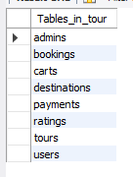
4) Truncate :-
The TRUNCATE TABLE statement is used to delete the data inside a table.
Output :-
Before :-
After :-

Slide 17
DML
( Data Manipulation Language )
This language commands are used to change or manipulate data in database tables.
DML commands :-
1) Insert.
2) Update.
3) Delete.

Slide 18
Inserts Data In Multiple Ways
First way :-
Insert single Values in tables.
Output :-

Slide 19
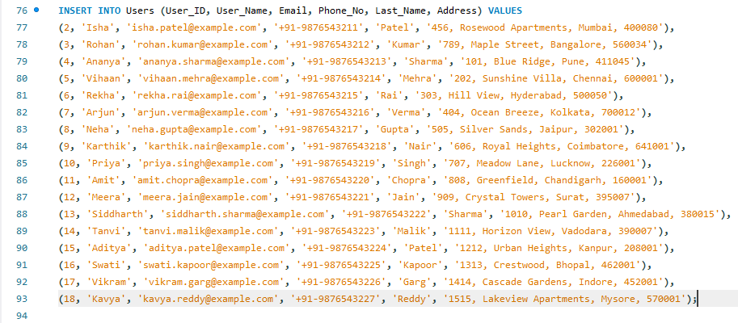
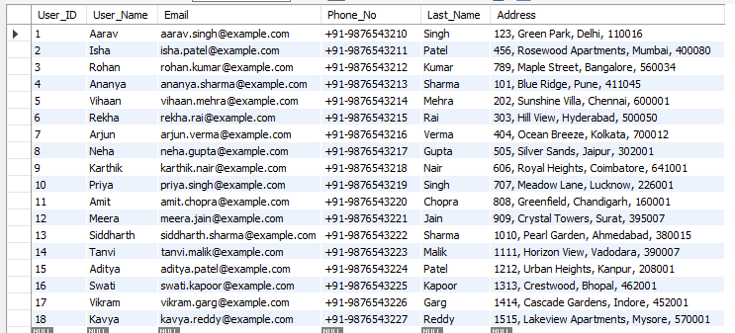
2) Second way :- Insert multiple values in tables.
Output :-

Slide 20
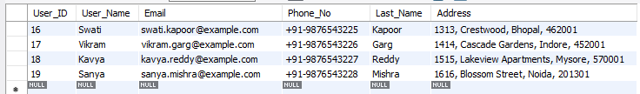
3) Third ways :-
Insert single values with column Name.
Output :-

Slide 21

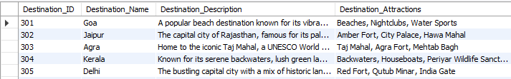
Update Query
1) Update single values using Where conditions :-
Output :-

Slide 22
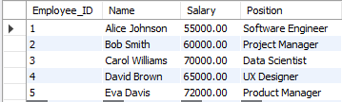
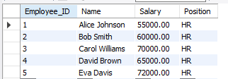
2) Update all data in single query :-
Output :-
Before
After

Slide 23

3) Delete
delete one row :
Output :-

Slide 24
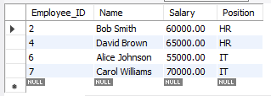

2) delete Multiple Rows :-
Output:-
After
Before

Slide 25


3) delete all records :-
Output:-

Slide 26
DQL
( Data Query Language )
SELECT command is used to fetch data from one or more tables in a database.

Slide 27
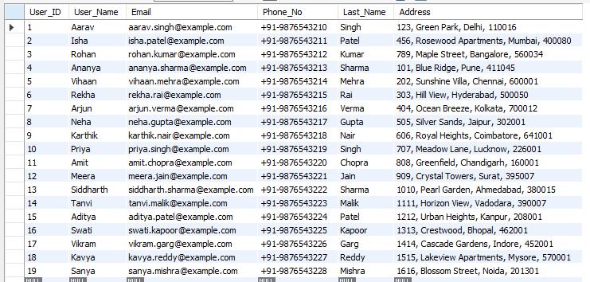
Select all date single Query :-
Output:-

Slide 28
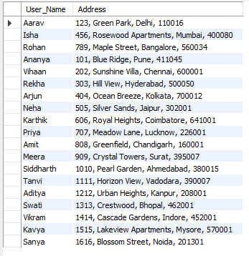
2) Select Specific column single Query :-
Output:-

Slide 29
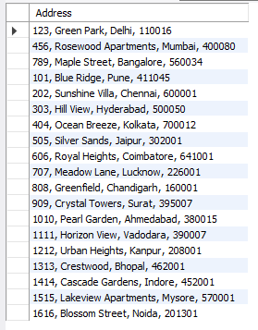
3) Select query using distinct :-
Output:-

Slide 30
Filtering Data
Filtering data in SQL means picking out only the rows from a table that match certain conditions.

Slide 31
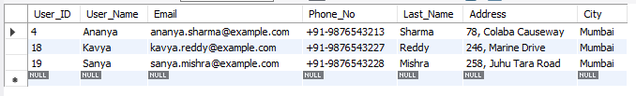
Where & Where AND
Select query using where condition :-
Output:-

Slide 32

Select query using where AND condition
Output:-

Slide 33
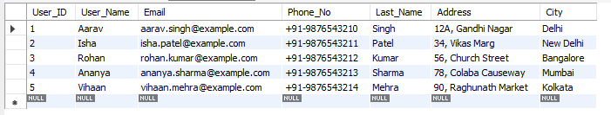
Range
Between :-
Output:-

Slide 34
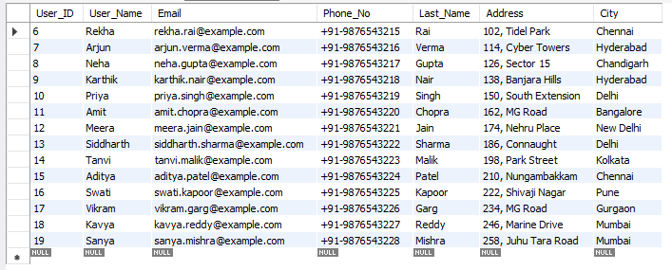
2) Not-Between :-
Output:-

Slide 35
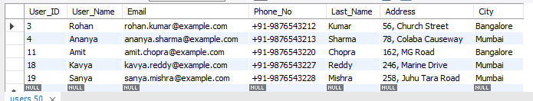
LIST Operator
In :-
Output:-

Slide 36
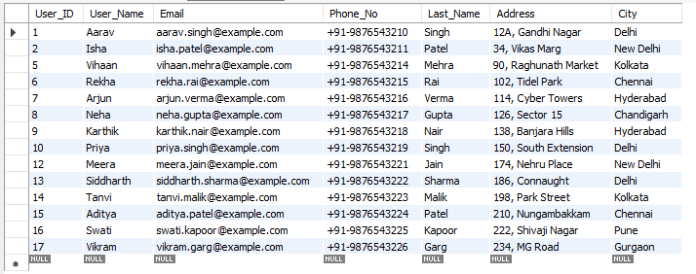
2) Not-IN :-
Output:-

Slide 37
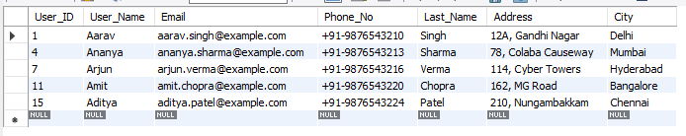
Like Operator
% symbol use to find single letter.
Output:-

Slide 38

2) _ to find end with letter in data.
Output:-

Slide 39
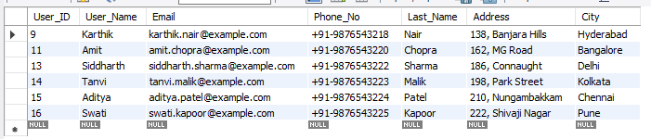
3) Find letter to any location :-
Output:-

Slide 40
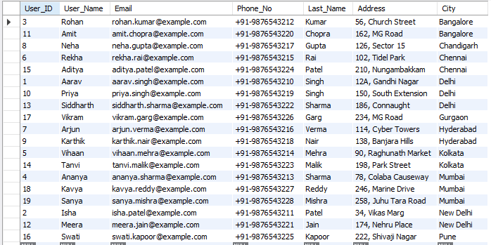
Order operators
Display data in ascending :-
Output:-

Slide 41
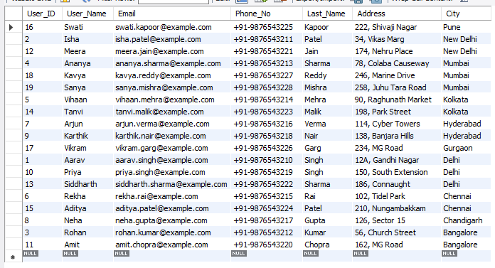
2) Display data in descending :-
Output:-

Slide 42

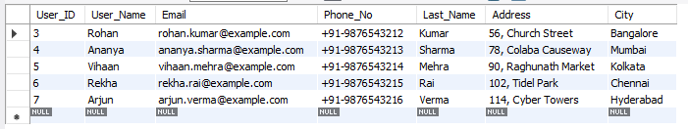
Limit operators
limit operators are used to control the number of rows returned by a query.
Output:-

Slide 43
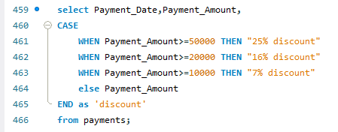
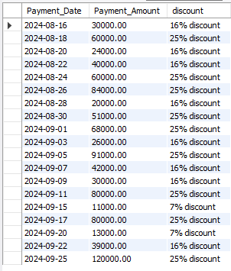
CASE STATEMENT
The CASE statement in SQL is used to perform conditional logic in queries.
Output:-

Slide 44
Aggregate Function
Aggregate means summarizing a group of rows into a single value.
For example, you can calculate the total, average, or count of a set of numbers.

Slide 45

Find Minimun payment :-
Output:-

Slide 46

2) Find maximum payment :-
Output:-

Slide 47

3) Find Average of payment :-
Output:-

Slide 48

4) Calculate Count number in table.
Output:-

Slide 49

5) To find total calculate amount :-
Output:-

Slide 50

Comparison Operator
Comparison operators in SQL are used to compare values and return a Boolean result (true or false) based on the comparison.
Equal to :-
Output:-

Slide 51
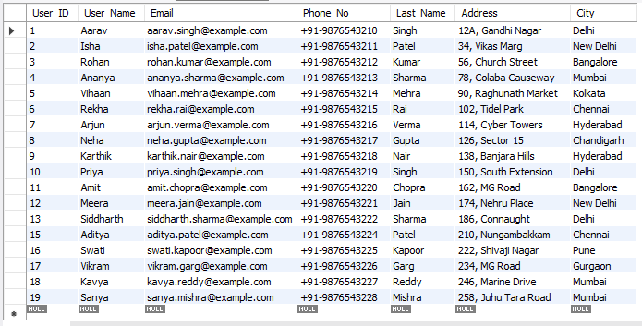
2) Not Equal To First Way:-
Output:-

Slide 52
2) Not Equal To Second Way:-
Output:-

Slide 53
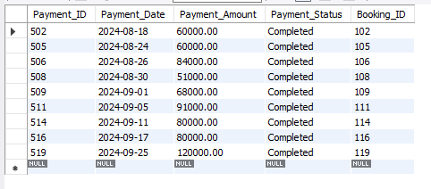
4) Greater than :-
Output:-

Slide 54
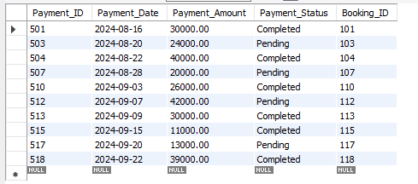
5) Less than :-
Output:-

Slide 55
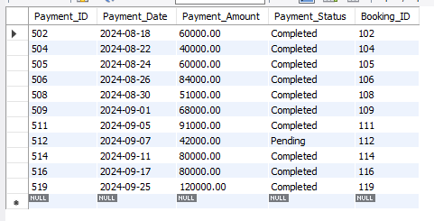
6) Greater Than equal to :-
Output:-

Slide 56
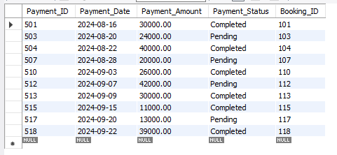
7) Less than equal to :-
Output:-

Slide 57
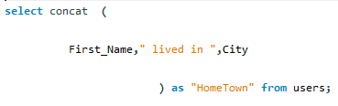
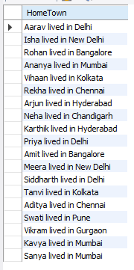
String function
Concat funcation :-
Output:-

Slide 58
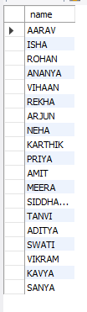
2) Upper funcation :-
Output:-

Slide 59
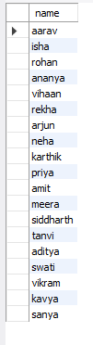
3) Lower funcation :-
Output:-

Slide 60

4) Length funaction :-
Output:-

Slide 61

5) char_length :-
Output:-

Slide 62
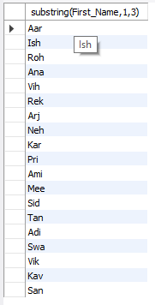
6) sup-string :-
Output:-

Slide 63
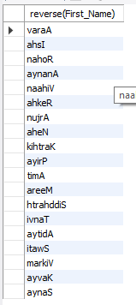
7) Reverse
Output:-

Slide 64

Date
To show current date :-
Output:-

Slide 65

2) Second Ways show Date
Output:-

Slide 66
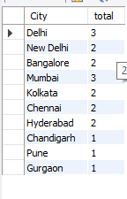
Group By
GROUP BY is a clause used to group rows that have the same values in specified columns into summary rows.
Output:-

Slide 67
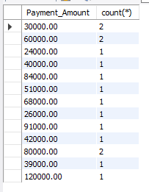
Having Clause
The HAVING clause in SQL is used to filter the results of a query based on aggregate function results.
Output:-

Slide 68

Sub-Query
Subqueries can be used to perform operations that require results from another query.
Single row sub-query.
Output:-

Slide 69

2) Multiple row subquery :-
IN :-
Output:-

Slide 70
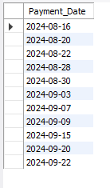
2) ANY :-
Output:-

Slide 71
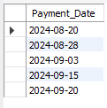
3) ALL :-
Output:-

Slide 72
Combining Data
Combining data in the process of merging data from multiple tables or queries into a single result result.

Slide 73
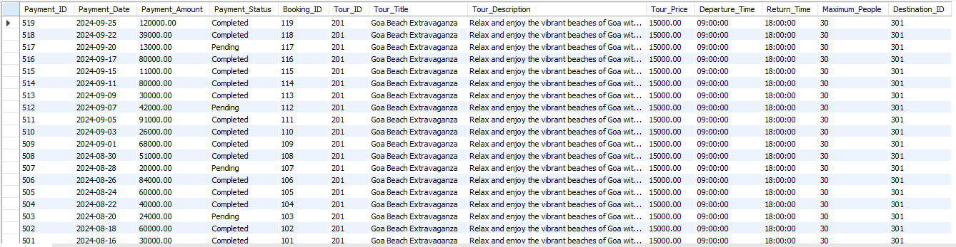
Joins
Cross Joins :-
Output :-

Slide 74

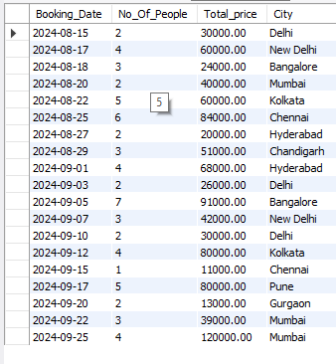
2) Inner Joins :-
1) ON Caluse
Output :-

Slide 75

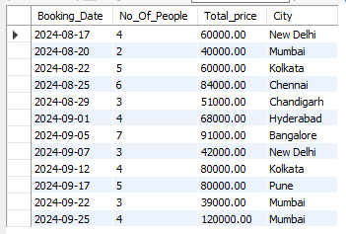
2) Where Clause
Output :-

Slide 76

3) Natural Joins :-
Output :-

Slide 77


4) Outer joins
1) Left joins :-
Output :-

Slide 78


2) Right joins :-
Output :-

Slide 79


Views
view is a virtual table created by a query that combines data from one or more tables.
Simple View :-
Output :-

Slide 80


2) Complex View :-
Output :-

Slide 81


Cursor
a cursor is a database object used to retrieve, manipulate, and navigate through a result set one row at a time.
Output :-

Slide 82



Store Procedure
A stored procedure in SQL is a saved set of SQL commands that you can run as a single operation.
Output :-

Slide 83



Triggers
A trigger in SQL is a special type of stored procedure that automatically executes in response to certain events on a table, such as insertions, updates, or deletions.
Output :-

Slide 84
Thank You

